Slide 1


MCKENNA GALLE KRISTEN CUNNINGHAM
TERSA ALMAW
ALEISHA SMITH

Slide 2
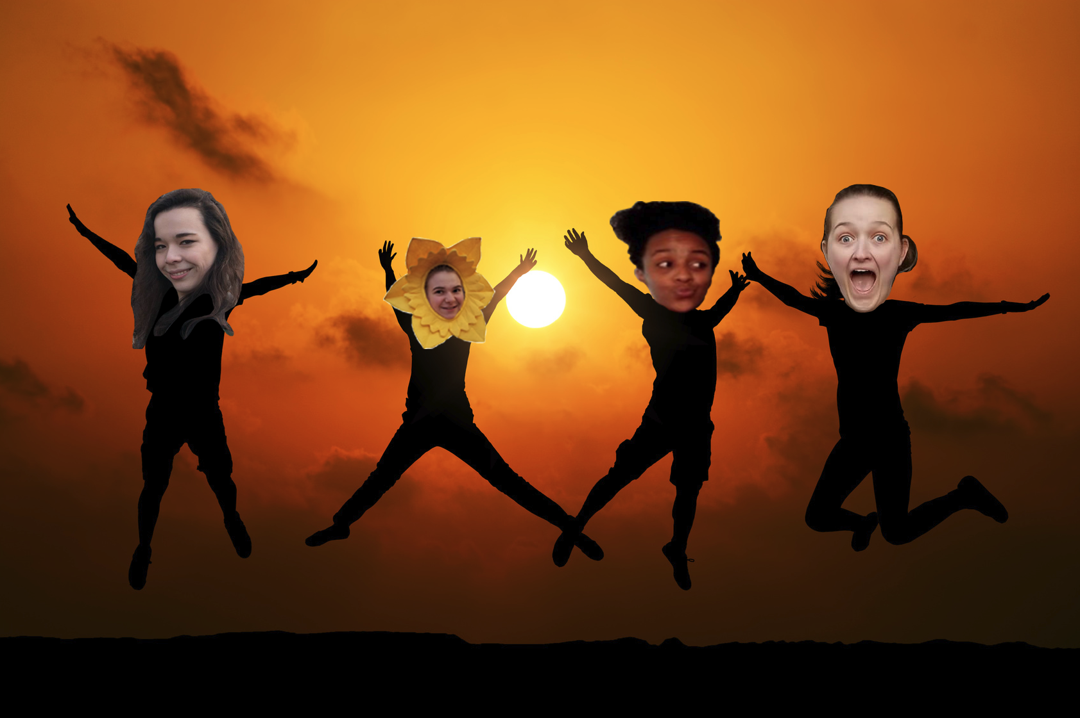
Goals
Multiple levels
Switch transportation within a level
Unique power ups
Special for each level
Some help and some hurt (if you hit a human you speed up)
Projectiles
Music
#Goals

Slide 3
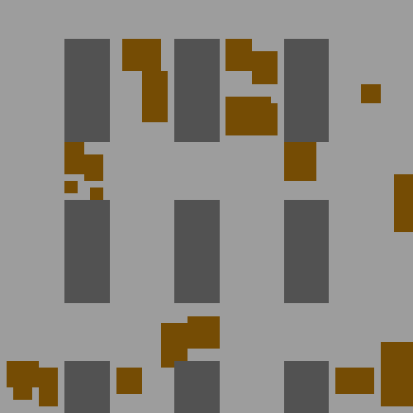


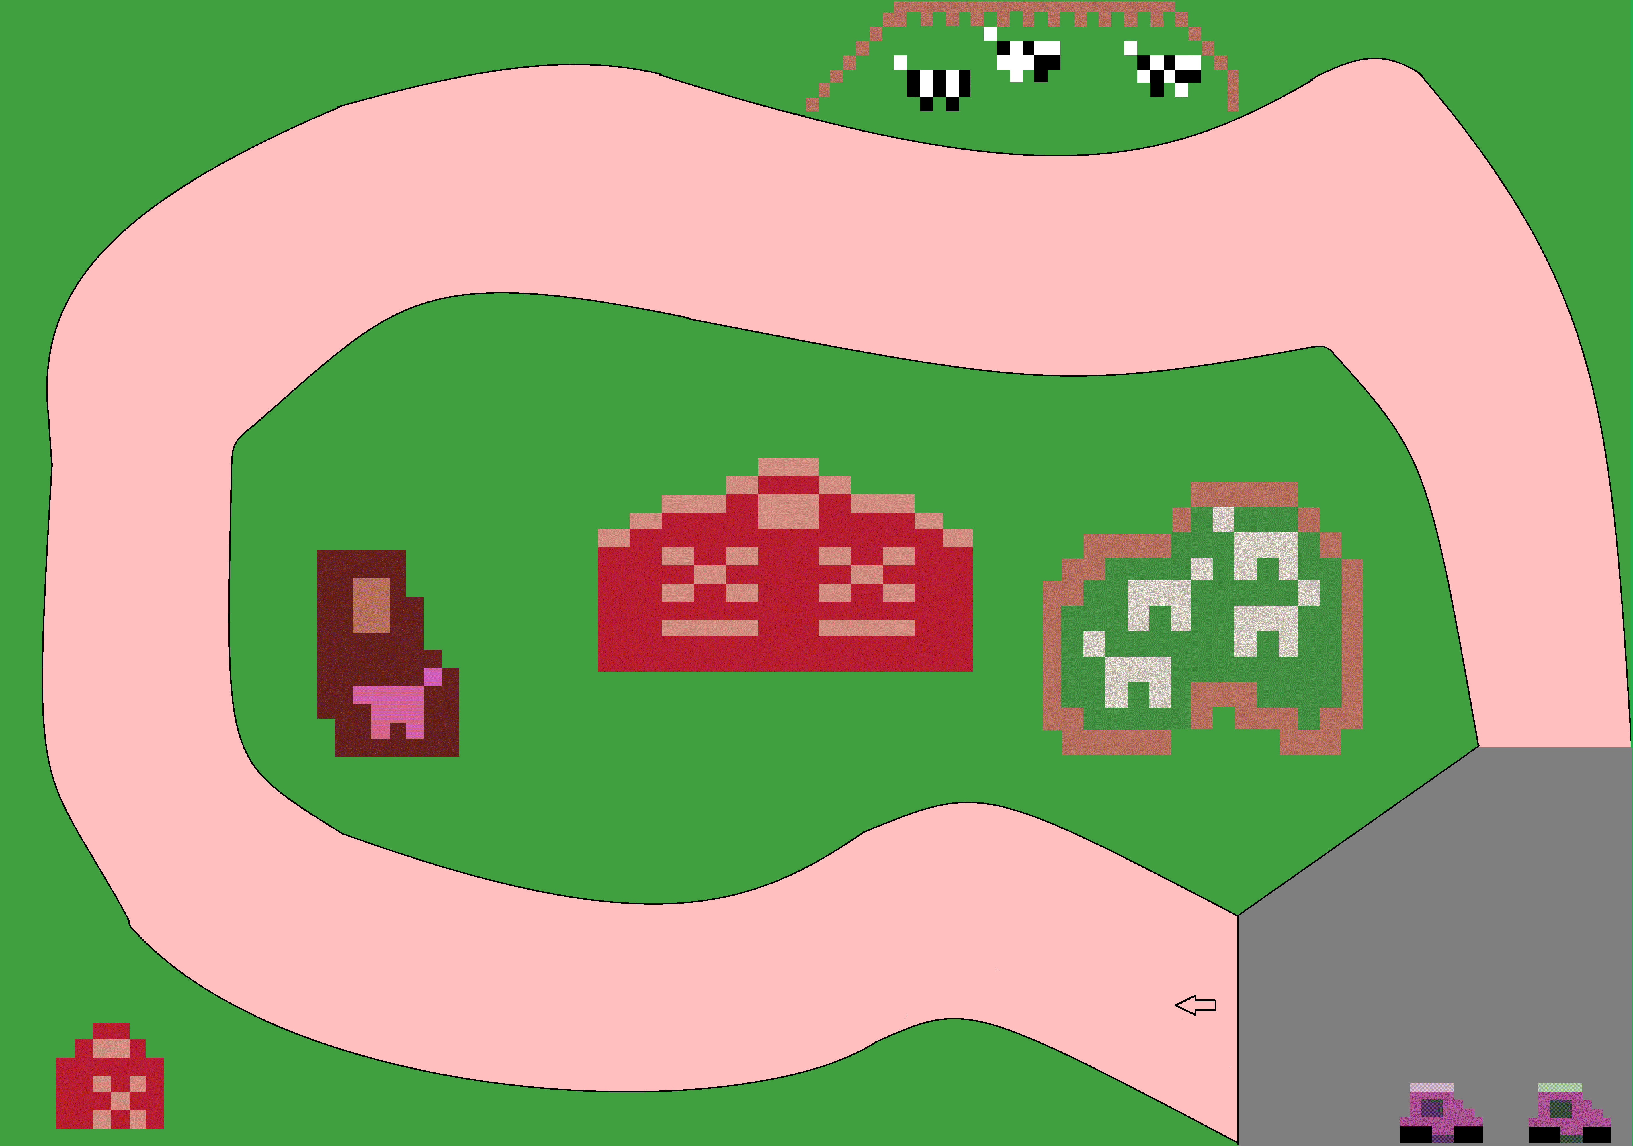
What did work
5 Different Levels
Power ups that help/hurt
Music

Slide 4
What didn’t work
Transitioning from one level to the next
Wouldn’t always recognize a lap
Ended up using a point system
Unique points for each individual level
Point icons are randomized but will appear in every level
Projectiles
Not enough time

Slide 5
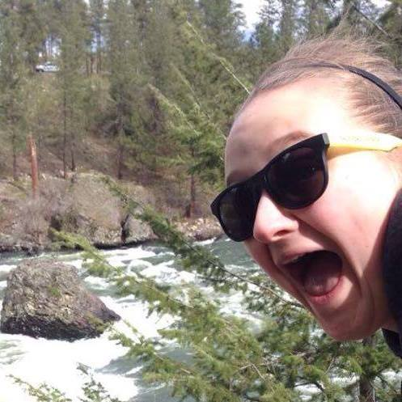
why
Sickness
McKenna
Not enough time

Slide 6
The future
Automatic switching to next level
Keeping track of who won
Projectiles (Pew pew pew pew pew)
NPC that get in your way
More levels (choose your own level/randomize levels)
Unique music per level

